Slide 1

GUI_3.0

Slide 2
Improvements
Add a tab select function
Add two new modules, one for parameter estimation and one for SOH/SOC display
Try to use a Pie map to dynamically show the SOH/SOC

Slide 3
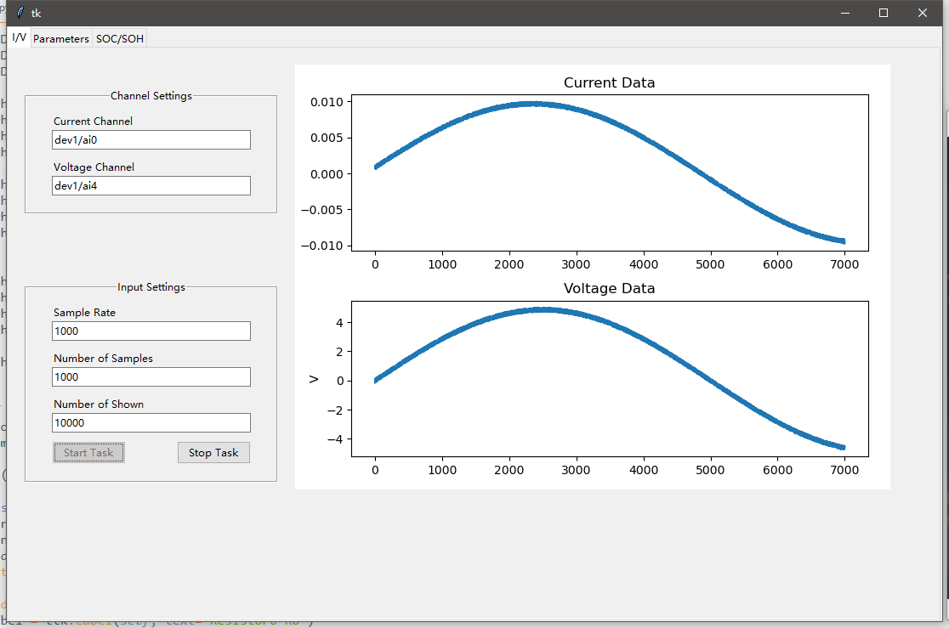
I/V data collection

Slide 4
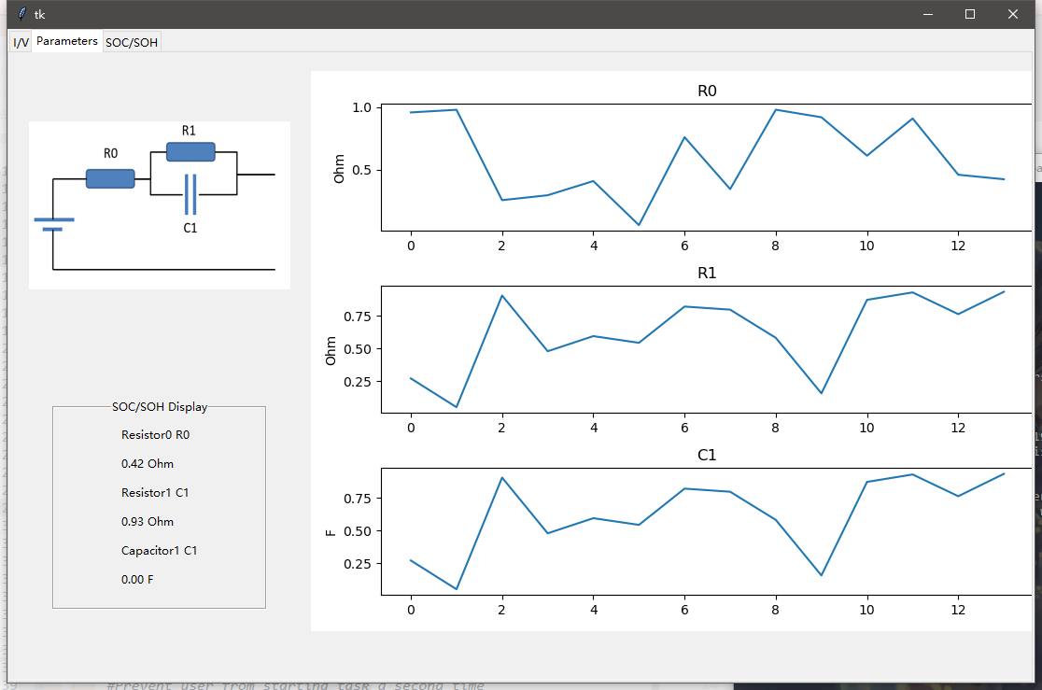
Parameters

Slide 5
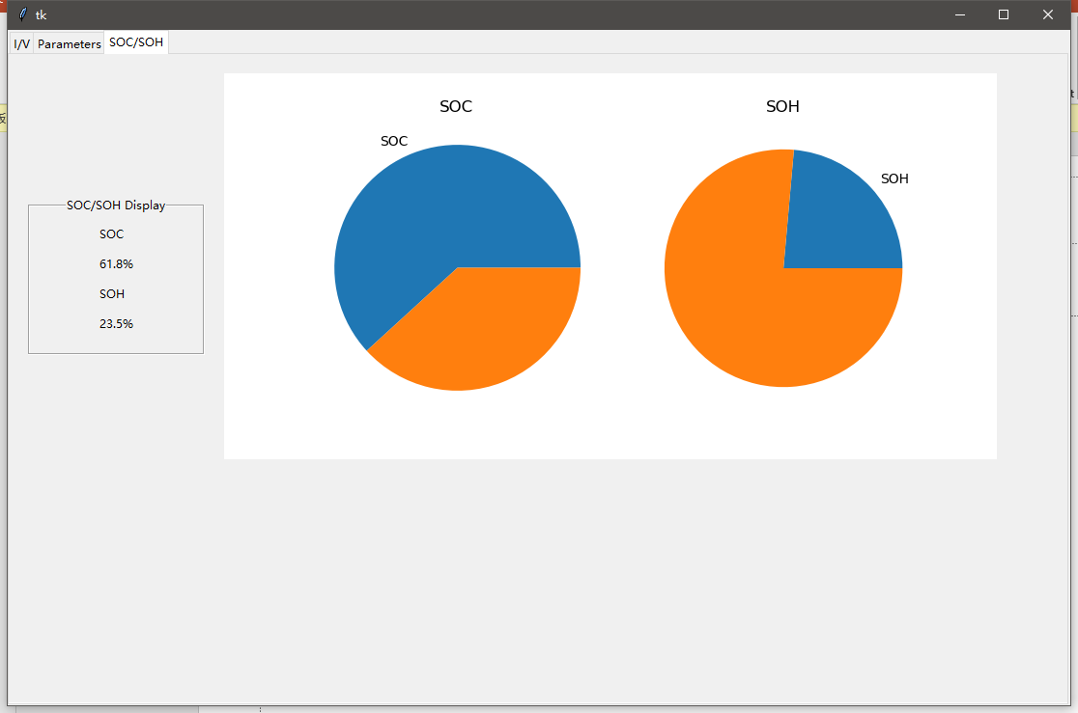
SOC/SOH Display

Slide 6

Thank you!

